Slide 1
SAS With Bitbucket & Jenkins Integration Steps

Slide 2
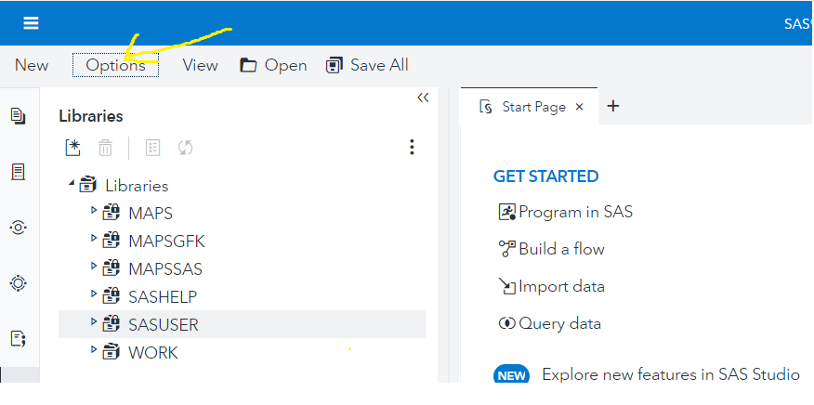
Click on the options → Manage Git connections

Slide 3
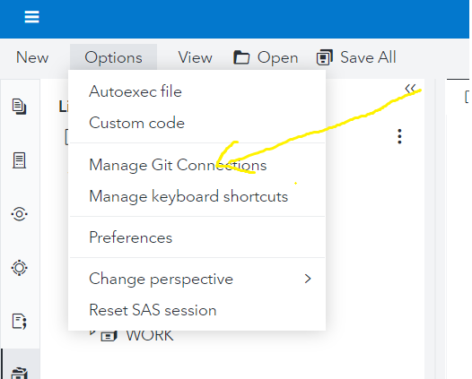
Click on manage Git connections:

Slide 4
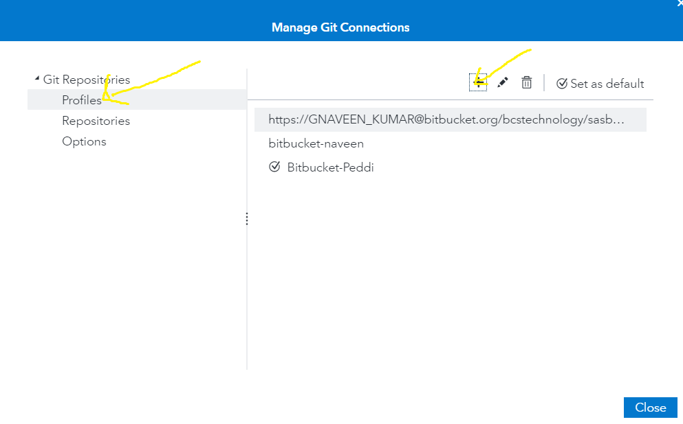
Click on Profiles → + sign

Slide 5
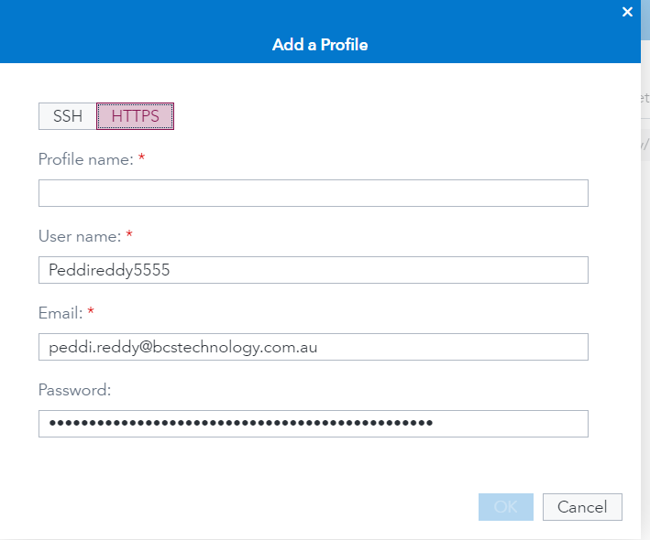
Provide the details and username should be Bit bucket account name.

Slide 6
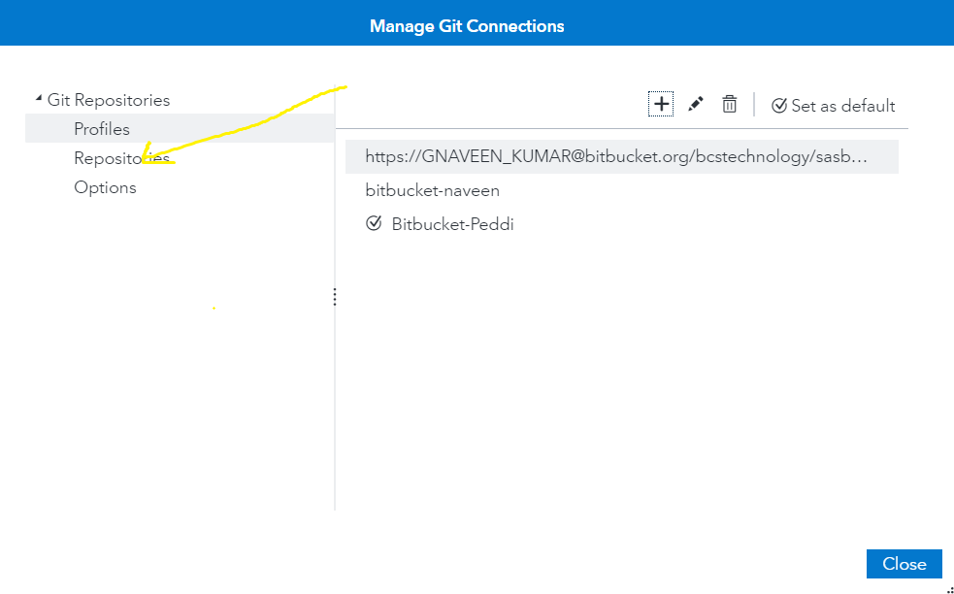
Click on Repositories → + and provide the details

Slide 7
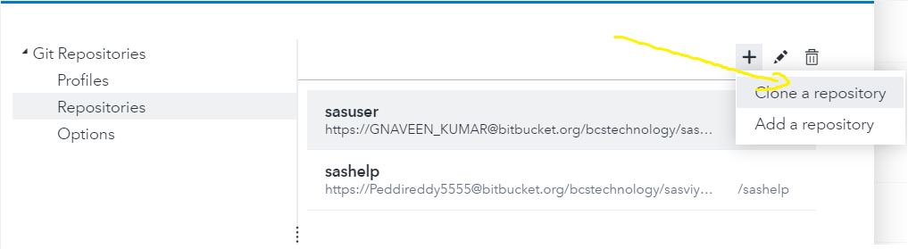
Click on Clone repository.

Slide 8
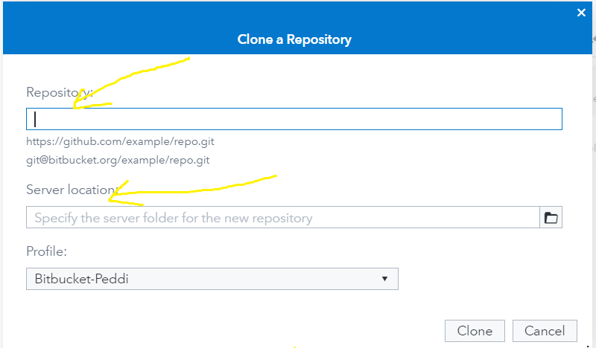
Provide the Bitbucket repository details and server Location.

Slide 9
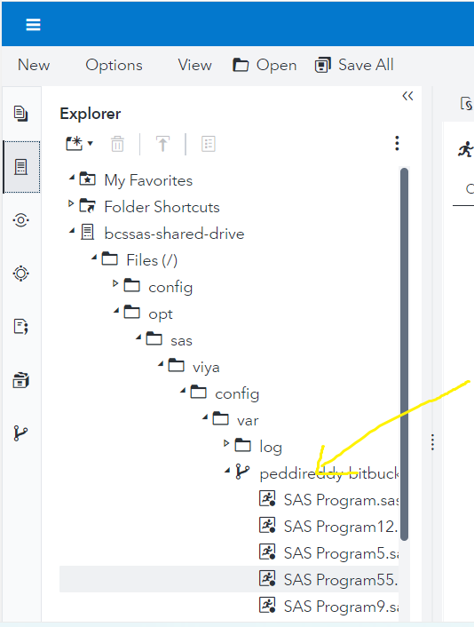
Add the server location:

Slide 10
Thank you

